Slide 1


Towards a Reference Architecture for NLP4RE Tools
Joint requirements elicitation at AIRE’25

Slide 2



Context
Towards a Reference Architecture for AIRE Tools: Joint requirements elicitation at AIRE’25
NLP-enabled tools supporting or solving RE-tasks are popular research artifacts involving a large ecosystem of datasets, ML/DL models, software components, information systems, and evaluation protocols.
Academic research has recently paid significant attention to this field, either through systematic mapping of such studies [1], guidelines for replication [2], and a handbook to guide the design and development of NLP4RE solutions [3].
However, the landscape of NLP4RE tools is subject to several unsolved challenges:
Lack of reuse and interoperability
Difficult maintainability
Low modularity and adaptability
[1] Zhao, L., Alhoshan, W., Ferrari, A., Letsholo, K. J., Ajagbe, M. A., Chioasca, E.-V., & Batista-Navarro, R. T. (2022). Natural language processing for requirements engineering: A systematic mapping study. ACM Computing Surveys, 54(3), Article 55, 1–41. https://doi.org/10.1145/3444689 [2] Abualhaija, S., Aydemir, F. B., Dalpiaz, F., Dell'Anna, D., Ferrari, A., Franch, X., & Fucci, D. (2024). Replication in requirements engineering: The NLP for RE case. ACM Transactions on Software Engineering and Methodology, 33(6), Article 151, 33 pages. https://doi.org/10.1145/3658669 [3] Ferrari, A., & Ginde, G. (Eds.). (2025). Handbook on natural language processing for requirements engineering (1st ed.). Springer. https://doi.org/10.1007/978-3-031-73143-3
Notes:
Lack of reuse and interoperability: Despite recurring functionality, most tools “reinvent the wheel” and implement everything from scratch.
Difficult maintenance: Most researchers do not have the time to maintain their tool long-term, which results in many abandoned artifacts.
Low modularity and adaptability: Most tools are monolithic, tightly coupled, making it difficult to upgrade, refine or adapt to different RE scenarios, technologies or datasets (i.e., input parsers, models, visualization modules)

Slide 3
Recurring Pattern of NLP4RE Tools
Towards a Reference Architecture for AIRE Tools: Joint requirements elicitation at AIRE’25
Input Consumer
Pre- Processor
Processor
Post- Processor
Output Producer

Slide 4

Towards a Reference Architecture for AIRE Tools: Joint requirements elicitation at AIRE’25
We believe that a software reference architecture for the design, development and deployment of NLP4RE tools can improve their (1) visibility, (2) reusability, (3) replicability, (4) interoperability, and (5) maintainability.
… and who better to help us that the ones that are designing, developing and using those tools?

Slide 5




Activity Description
Towards a Reference Architecture for AIRE Tools: Joint requirements elicitation at AIRE’25
As stakeholders for NLP4RE tools, we invite you to join us in the elicitation of requirements for such a reference architecture consisting of the following:
Activity 1. Elicitation (15 minutes) - Form equally-sized groups around the topics on the walls, assign a moderator, and elicit user-level requirements that you perceive to be relevant.
Activity 2. Adding and re-ranking (10 minutes) - While the moderator remains with the selected topic, distribute the rest of the team among all other topics and assess the relevance of the respective requirements.
Consider the perspective(s) you are more familiarized with: either as a producer or as a consumer of NLP4RE tools.
By participating in this study, you provide informed consent for your contributions and results to be used in the development and publication of a software reference architecture.

Slide 6
Activity 1: Elicitation (15 minutes)
Towards a Reference Architecture for AIRE Tools: Joint requirements elicitation at AIRE’25
Form equally-sized groups around the topics on the walls and elicit user-level requirements for a shared reference architecture of NLP4RE tools that you perceive to be relevant.
A
Functional requirements. What generic functions should an NLP4RE tool fulfill? What is missing from current solutions? How should tools support pipeline flexibility (e.g., plug-and-play modules)?
B
Non-functional requirements. What quality attributes of an NLP4RE tool are important (e.g., explainability, latency, robustness)? How do NFRs differ according to tool maturity?
C
Domain concepts. Which elements of NLP4RE tools are relevant to frame? What are key input/output data entities?
D
Shared services & data. What architectural services are typically reused? What types of data sources (e.g., model hubs, knowledge bases, dataset repositories) should be standardized?
E
GenAI challenges. Which challenges emerge from consuming and operationalizing GenAI? What design patterns work best for explainability and traceability?
Notes:
Note: these topics are only rough groups that shall stimulate the requirements elicitation
We expect overlap between them.
We coordinators will take care of the overlap.
The participants should not worry about interfering with other areas.

Slide 7

Activity 1: Elicitation (15 minutes)
Towards a Reference Architecture for AIRE Tools: Joint requirements elicitation at AIRE’25
AIRE Joint Activity
Group {X}: {NAME}
high
Write down user-level requirements
Rank them based on priority and complexity
Priority
Don’t write on the sheet (yet!)
low
Complexity
high
Notes:
Note: these topics are only rough groups that shall stimulate the requirements elicitation
We expect overlap between them.
We coordinators will take care of the overlap.
The participants should not worry about interfering with other areas.

Slide 8
Sheet design
AIRE Joint Activity
Group {X}: {NAME}
high
maybe in Activity 1 we can ask participants to:
write post-it notes
propose a placement on the 2-dimensional axis
don’t write anything on the sheet (because people might later move the post-it notes)
Then, we take some pictures
This way, we immortalize the status of the sheet BEFORE re-ranking, making sure we also capture this divergences
then in Activity 2 we ask participants to
reorder/rerank requirements in 2-dimensional space (if they think it makes sense)
add notes/comments on blank sheet (e.g., relationships, clusters, etc…)
vote with stickers or marks
cluster X
Priority
low
Complexity
high

Slide 9
Activity 1: Elicitation (15 minutes)
Towards a Reference Architecture for AIRE Tools: Joint requirements elicitation at AIRE’25
Specify requirements using post-it notes in the following way.
<formulate the requirement in NL text>

Slide 10


Activity 2: Adding
and re-ranking (10 minutes)
Towards a Reference Architecture for AIRE Tools: Joint requirements elicitation at AIRE’25
AIRE Joint Activity
Group {X}: {NAME}
high
While the moderator remains with the selected topic, distribute the rest of the team among all other topics and:
Discuss with the moderator the topic and previous requirements
Rerank requirements (only if necessary)
Add missing user-level requirements (only if necessary)
Write any notes on the sheet if needed
cluster X
Priority
low
Complexity
high

Slide 11
Disclaimer
Towards a Reference Architecture for AIRE Tools: Joint requirements elicitation at AIRE’25
Don’t worry about:
Suitability of a requirement to a given topic
We expect some overlap!
Exhaustivity and completeness of requirements
Focus on what you know and you perceive relevant
Disagreement resolution
If no consensus is reached, document it!

Slide 12
Sheet design
AIRE Joint Activity
Group {X}: {NAME}
high
maybe in Activity 1 we can ask participants to:
write post-it notes
propose a placement on the 2-dimensional axis
don’t write anything on the sheet (because people might later move the post-it notes)
Then, we take some pictures
This way, we immortalize the status of the sheet BEFORE re-ranking, making sure we also capture this divergences
then in Activity 2 we ask participants to
reorder/rerank requirements in 2-dimensional space (if they think it makes sense)
add notes/comments on blank sheet (e.g., relationships, clusters, etc…)
vote with stickers or marks
cluster X
Priority
low
Complexity
high

Slide 13
Wrap-up
Towards a Reference Architecture for AIRE Tools: Joint requirements elicitation at AIRE’25
As a moderator of a group, state the most important aspects elicited and voted on.
A
Functional requirements.
B
Non-functional requirements.
C
Domain concepts.
D
Shared services & data.
E
GenAI challenges.

Slide 14


The road ahead
Towards a Reference Architecture for AIRE Tools: Joint requirements elicitation at AIRE’25
Thank you for your input! Based on your elicited and prioritized requirements, we will abstract the requirements for a shared reference architecture.
Interested in contributing? Contact us for the research ahead. We plan to:
propose and implement the reference architecture,
re-implement existing tools based on that reference architecture, and
maintain the reference architecture and its modules.
If you are interested in this work, you are more than welcome to join us.
Julian Frattini
Chalmers University of Technology, Sweden
julian.frattini@chalmers.se
Quim Motger
Universitat Politècnica de Catalunya, Spain
joaquim.motger@upc.edu

Slide 15
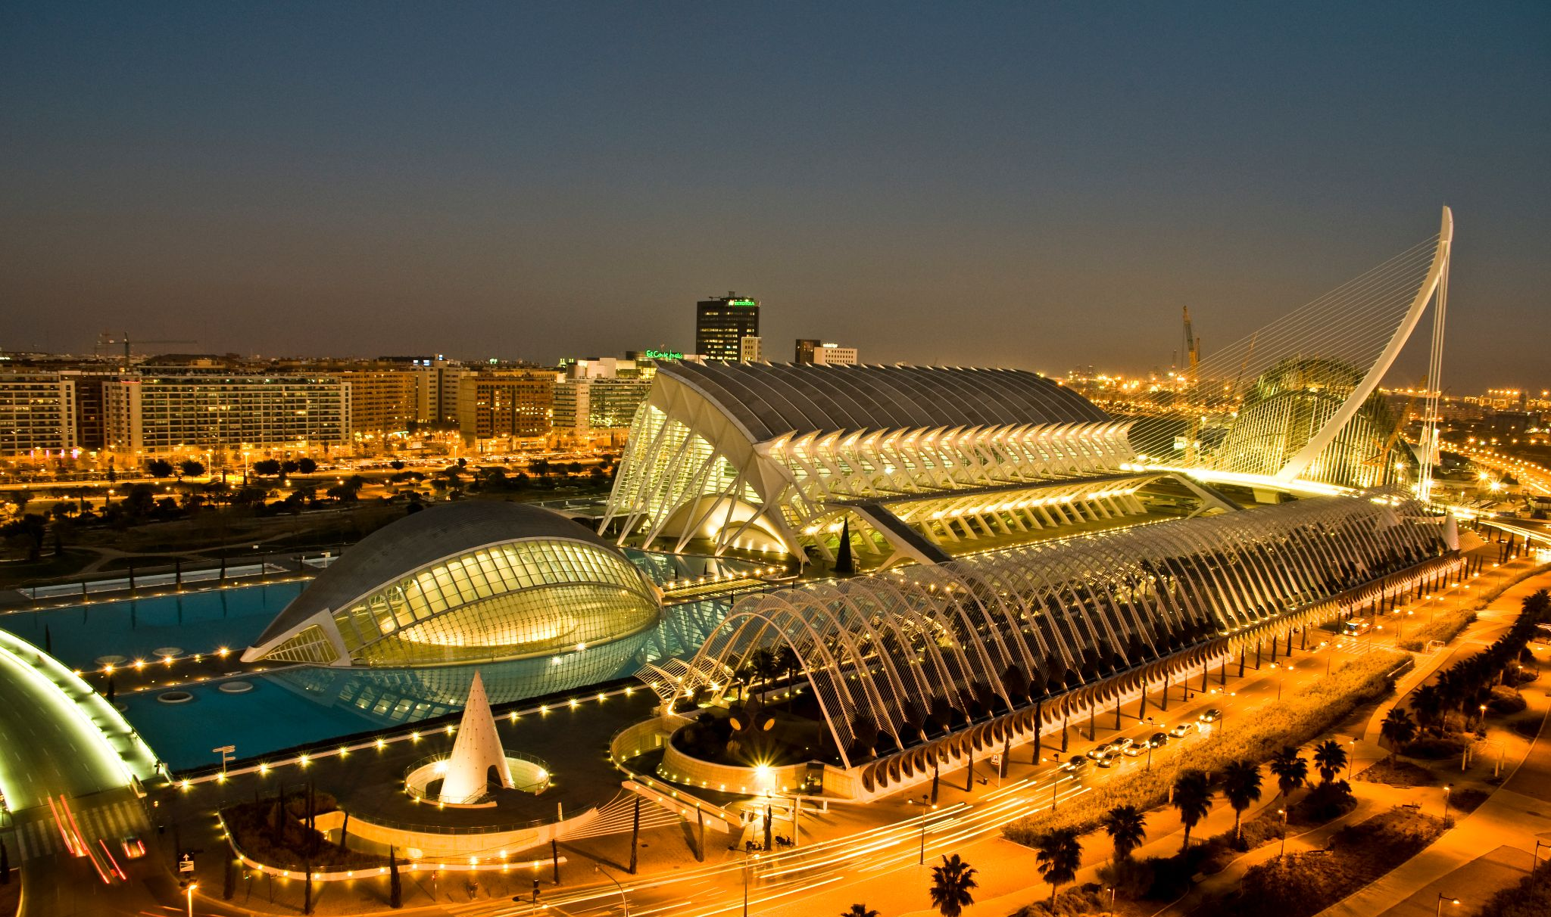
AIRE 2025: 12th International Workshop on Artificial Intelligence and Requirements Engineering

Slide 16
Thank you
AIRE 2025: 12th International Workshop on Artificial Intelligence and Requirements Engineering
We are immensely grateful to
All authors who submitted their hard work to the AIRE workshop,
All reviewers who took their time to evaluate the submitted manuscripts,
The AIRE steering committee for supporting us organizers,
All of you attendees for the lively discussion and interest.
If you are interested in contributing further (e.g., serving as a reviewer or organizer), please reach out to the workshop organizers and steering committee.
https://aire-ws.github.io/aire25/index.html

Slide 17

Workshop Feedback
AIRE 2025: 12th International Workshop on Artificial Intelligence and Requirements Engineering
If not already done, please share your experience with the workshop.
https://aire-ws.github.io/aire25/index.html

Slide 18
AIRE 2025: 12th International Workshop on Artificial Intelligence and Requirements Engineering
Have a fantastic RE’25 conference And see you for AIRE’26 in …?
https://aire-ws.github.io/aire25/index.html

